Slide 1

Six Common and Concerning Childhood Poisons
“
Amanda Ruback, MSN, RN, CSPI

Slide 2
LEARNING OBJECTIVES
01
02
03
Upon completion, the participant will be able to:
Recognize six common and concerning poisons that affect children.
Demonstrate knowledge about how poison centers can be used to assist in the mantagement of a poisoned child.
Understand the harm reduction strageies relating to poisons in childhood.

Slide 3
60%
“
Notes:
~60% of calls to the MPC in 2023 were for children under 19 years of age

Slide 4

Hand to mouth behavior
Curiosity
Look-alikes
Imitation
5 Years and Younger
Notes:
In the first year, babies learn to focus their vision, reach out, explore, and learn about the things that are around them.
Babies are at greater risk for poisoning because as they reach out to explore - they touch, grab, taste, and put things in their mouth as they learn about the world surrounding them. This hand to mouth behavior is a normal growth and development stage for babies.
Babies grow into toddlers and become more mobile and naturally curious about the things they find.
Children also imitate others and often do not understand the difference between right and wrong. Kids love to mimic what they see adults do.
Children may confuse things that look alike because they cannot read labels and many products around the home look like candy, or something tasty to eat or drink

Slide 5

Independence
Time alone
Magical thinking
Dares
6-12 Years
Notes:
For Children ages 6-12 years. The risk factors for poisoning include:
Independence: As children get older, they become more independent. They feel they can do more on their own, which can lead to medicine mishaps.
Spending time alone: As children get older, there is less adult supervision. This leaves time for the children to experiment with medicines and household products.
Magical thinking: When children are faced with choices, they do not always use proper logic to make those choices. They will come up with reasons to support their choice, even if those reasons make no sense to adults.
Inability to associate cause and effect: Children do not think bad things will happen to them. They think bad things only happen to "someone else."
Inability to understand label directions: Children may misread or misinterpret medicine or household product labels. They may not fully understand the instructions, leading to a mishap with the medicine or product.
Dares: Most children are faced with a dare from a friend or classmate at some time or another. Many dares are harmless; others can have severe consequences.
Introduction to substance abuse: Studies show that children are experimenting with drugs, alcohol, tobacco, and household products at a younger age.

Slide 6

Workplace
Stress
Peer Pressure
Misconceptions
Tweens and Teens
Notes:
For Teens/Tweens, the risk factors for poisoning include:
Inability to Understand Label Directions: Even when using a medicine or a household product for its intended purpose, teens are at risk for poisoning if they don't read the label fully or if the information is confusing.
Workplace Exposures: A job provides a teen with responsibility and financial resources. However, he or she may not have proper training or supervision when using potent degreasers, cleaners, or other chemicals at their workplace. Remind teens to read product labels and follow directions exactly when using cleaning products and chemicals at work.
Stress: Teens are under stress from multiple sources. Grades, family pressures, and busy social lives can collide to make some situations unbearable for teens. Some may turn to medications or illicit drugs to take the edge off, while others may feel there is no way out other than ending their lives.
Peer Pressure/Substance abuse: Trying to fit in with friends puts an enormous amount of pressure on teens. Use of alcohol, inhalants, over-the-counter medicines, prescriptions medicines, or illicit drugs might be seen as a way to fit in with a group of friends.
Misconceptions About Medicine Safety: Many teens think that over-the-counter medicines are safer than prescriptions medicines, which are safer than illicit drugs. In reality, all are equally dangerous when not used correctly.
The Internet and social media: There is so much useful information on the internet, but there is also some misinformation Be aware of the various videos and "challenges" that they are viewing.

Slide 7
SIX COMMON AND CONCERNING POISONS
01
“

Slide 8
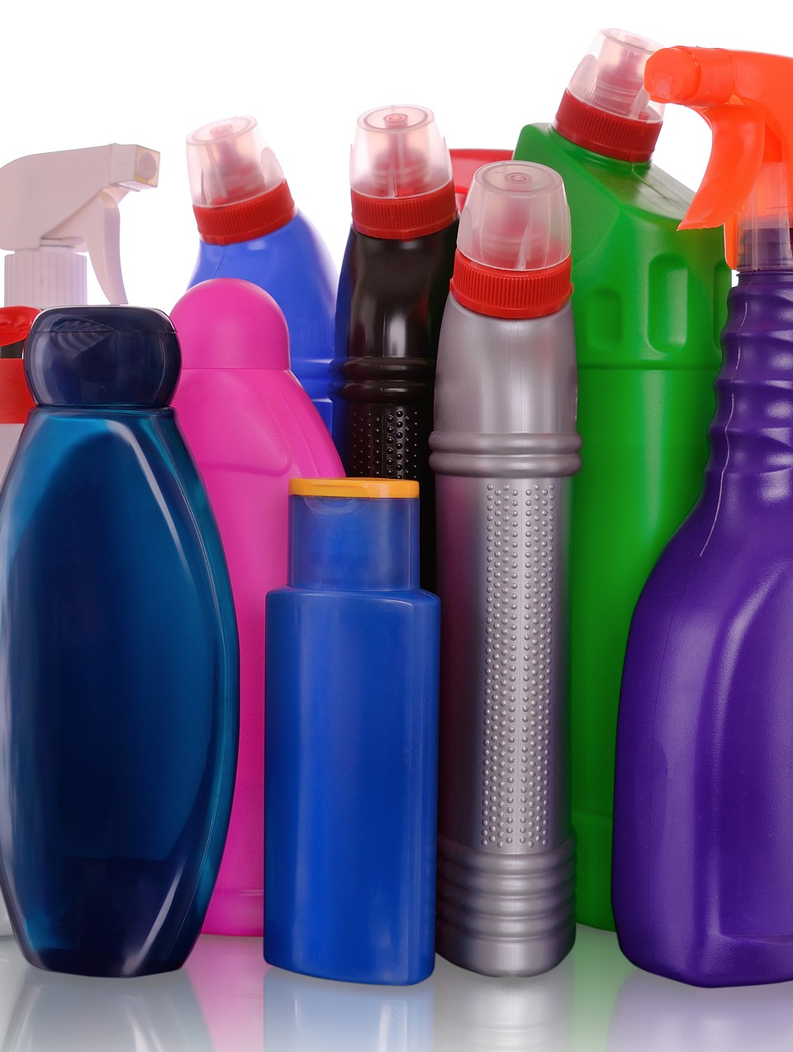
CLEANING PRODUCTS

Slide 9



Drain Cleaners
Toliet Bowl Cleaners
Laundry Detergent

Slide 10
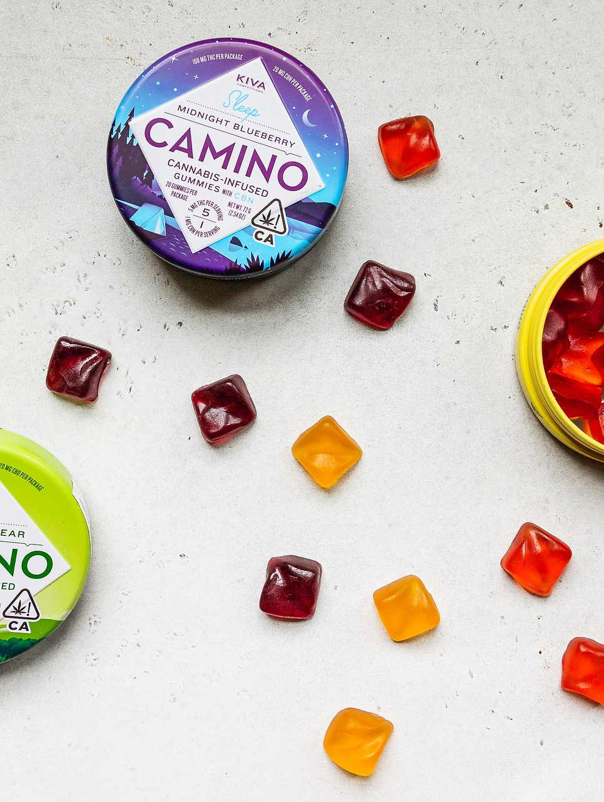
CANNABIS
“
Notes:
With the wider use of and availability of cannabis comes the risk of increased exposure. We have seen a steady increase of calls related to children 5 years or younger consuming cannabis. Our data shows that the total number of calls has more than doubled every year since 2018. So, in 2020-2021 we see a large increase in total calls.
Pediatric Poisonings Associated with Ingestion of Marijuana Products
#1245 pediatric patient visits in children 0-11 years
77% were for children under 5 years
Male 51%
Edible 578%
55.5% admitted or transferred
60% summer/spring

Slide 11
Notes:
At the Missouri Poison Center, we have seen a steady increase of calls related to children 5 years or younger consuming cannabis. Our data shows that the total number of calls has more than doubled every year since 2018.
Most were edibles but other cannabis products including concentrates, dried plant, capsule/pill, unknown, vape liquid, etc.
Between 2018 to 2022 there was a 1685% increase in cannabis cases in children under 5 years to the MPC

Slide 12


Cannabis Symptoms in Children
Lethargy
Loss of Balance
Slurred Speech
Fast Heartrate
Seizure
Trouble Breathing
Notes:
Symptoms can be severe and prolonged and can include:
Loss of balance
Slurred speech
Extreme tiredness or lethargy
Paranoia or confusion
A racing heart
Difficulty breathing
Seizure
If symptoms are severe enough, young children may need to be taken to the hospital for emergency care.
Because of their size and weight, small children are at a higher risk of overdose if they mistakenly ingest edible marijuana. This type of overdose is especially troubling because symptoms may take time to appear and can last for several hours.
National data: 15% moderate symptoms, 1.4% severe symptoms
https://www.health.harvard.edu/blog/edibles-and-children-poison-center-calls-rise-2021042322450

Slide 13
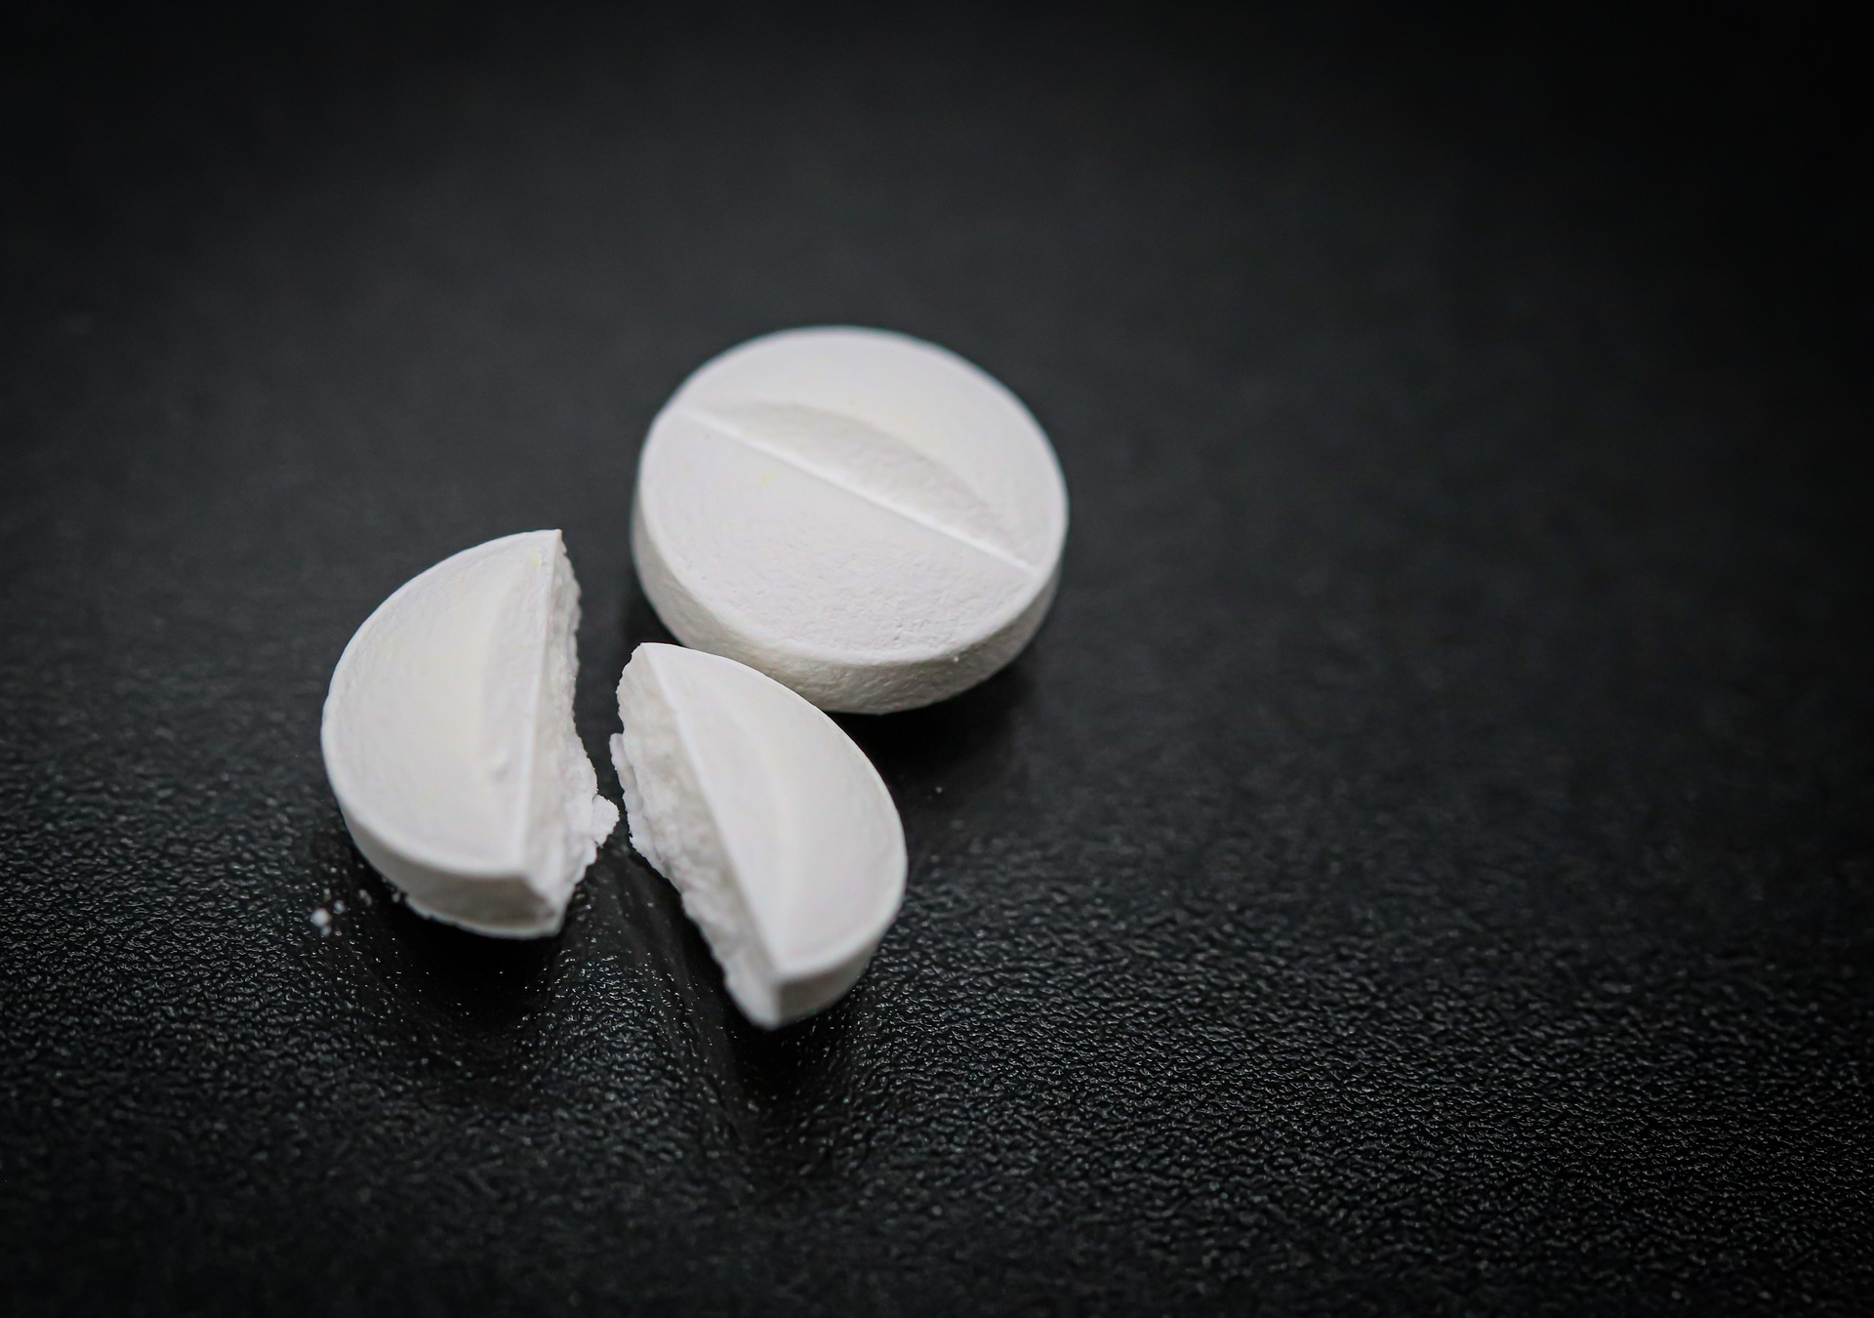
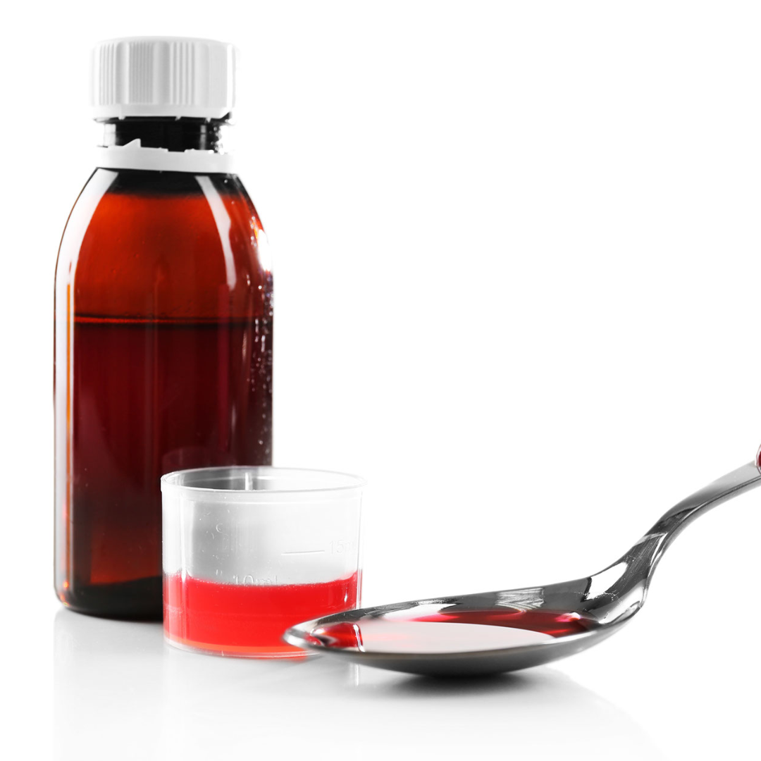
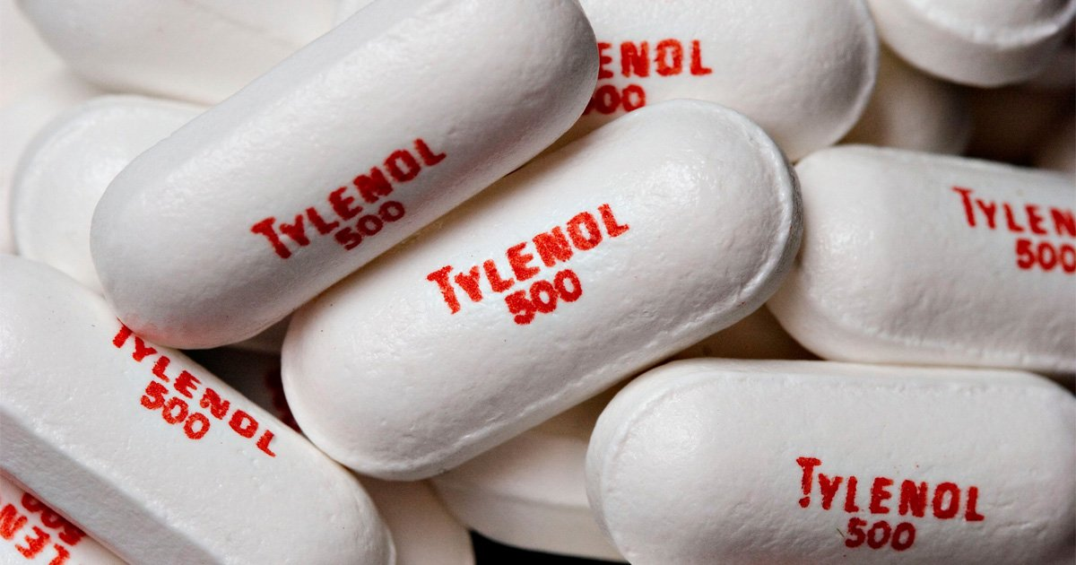

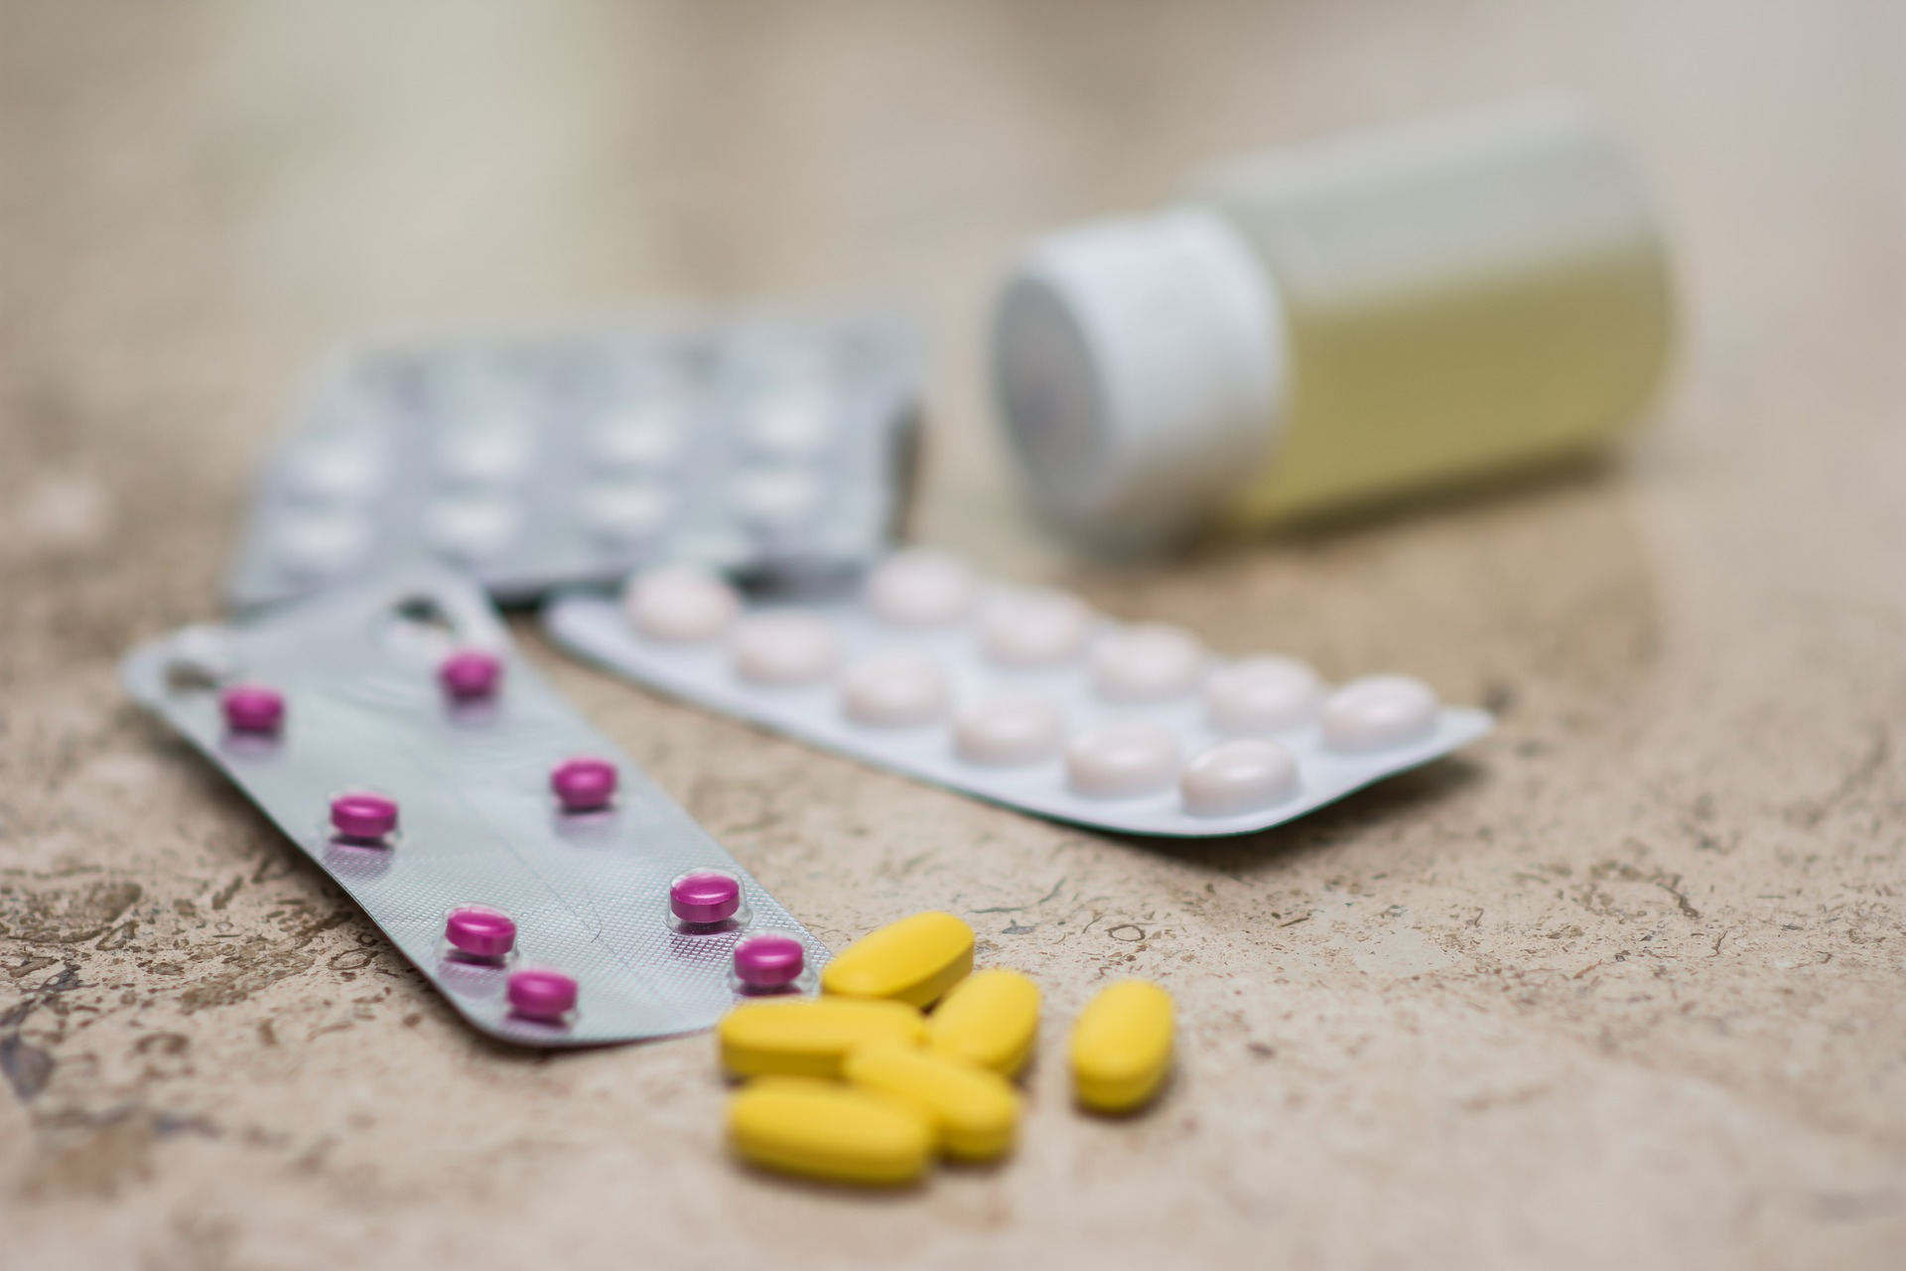
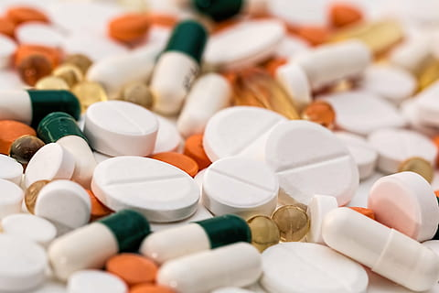
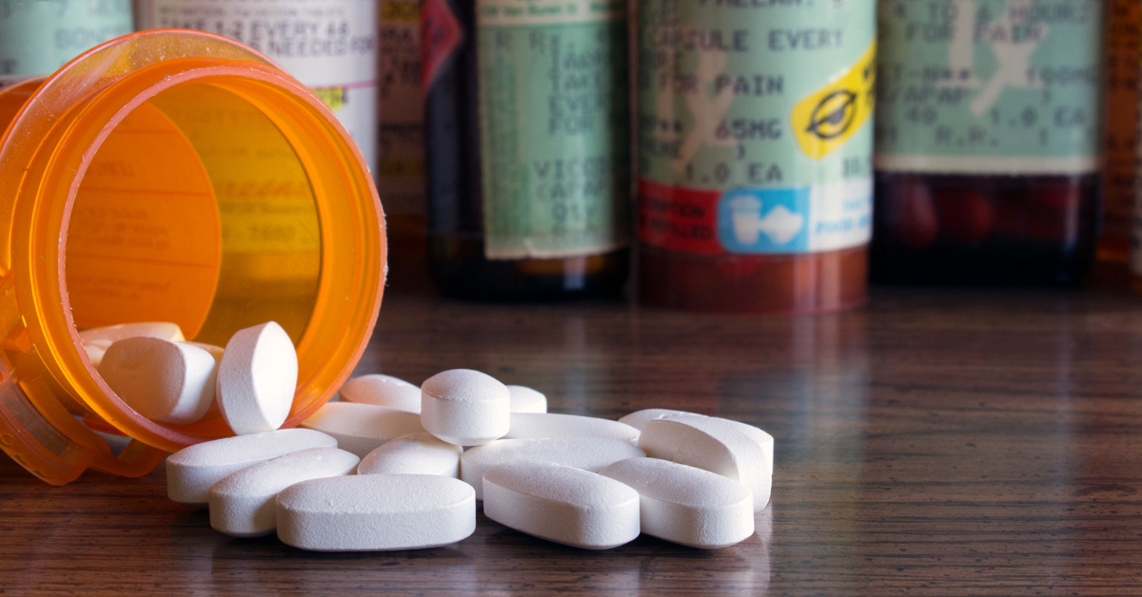
MEDICATION
Notes:
Most commons medication in 0-5 and 6-12 years: Melatonin
Liquids-appeal to kids, drink a lot, cold/cough
Pain relievers—chewable, liquid, melts, adult (Tylenol)
Prescription meds—especially heart, mental health, blood thinners

Slide 14
Percent of exposures that involve medicine
50%
69%
66%
0-5 Year Olds
6-12 Year Olds
Tween/Teen

Slide 15
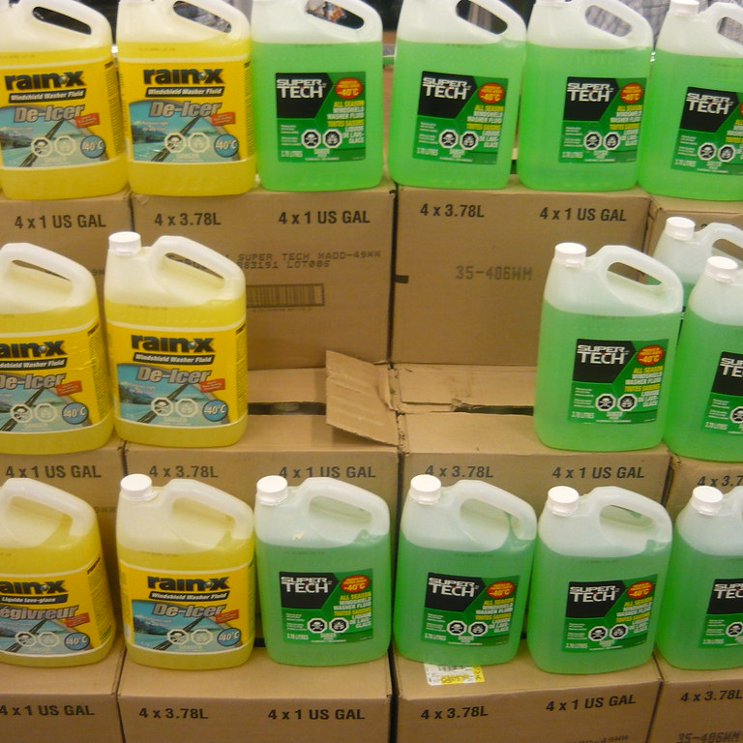
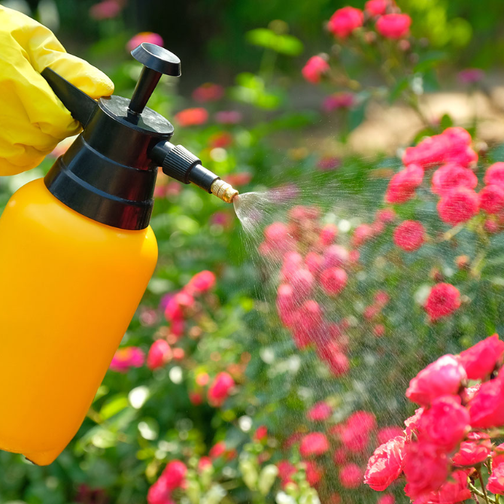
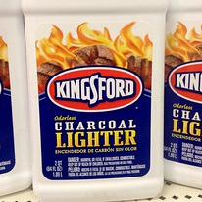
GARAGE STUFF
Pesticides
Hydrocarbons
Automotive Products
Notes:
Does anyone actually use their garage for their cars? There *may* be room for a car among the bicycles, ladders, holiday decorations, hoses, tools and equipment, leftover home improvement supplies, birdseed, paint cans, toys, car maintenance and lawn care products.
AUTO SUPPLIES
Antifreeze, windshield washer fluid, carburetor cleaner, fuel additives, and similar products for cars have a wide range of formulations. Some ingredients, such as ethylene glycol or methanol, can be toxic even if only a mouthful is swallowed. The victim could become very sleepy and perhaps slip into a coma. If special treatment isn’t started in time, there could be permanent injury to kidneys or eyes. People have died from drinking a glassful.
Some types of auto products have volatile ingredients that can flash into a fire. If the container is left open, the vapor permeates the air and can be ignited by a distant spark or flame, all the way back to the open bottle. Driveway fireworks? Outdoor barbeque grill? Somebody smoking? Want a flash fire? Then cap tightly and put the products away and out of reach.
LAWN AND GARDEN PRODUCTS
The products sold to homeowners, such as fertilizers and herbicides, are generally harmless to people. Contact with them might cause a light rash, allergic reaction, or eye irritation.
Insect killers for the home setting are more of a “mixed bag.” The most common type are called “pyrethroids” and they were first discovered in the chrysanthemum flower. If these get on the skin, strange sensations like a blend of numbness and tingling can occur. This can be treated with gentle washing, and then squeezing the liquid inside of a Vitamin E capsule onto the skin and rubbing it in.
Some other types of insecticides are more toxic to pets and people. These products have been sold for a long time, so their names, such as malathion and carbaryl, may be vaguely familiar. They have a characteristic, unmistakable “poisonous” smell. These older insecticides can make a person or a pet quite sick, whether they eat or drink it, or get it on their skin and clothes (or fur) and don’t wash it off right away. Drooling, vomiting, diarrhea, sweating, difficulty breathing and muscle weakness can appear out of nowhere. Luckily, there is an effective antidote in the emergency room.
The best overall advice is to select and use the right product for job. Also choose a product with the word “Caution” on the label, which indicates it is a less toxic alternative to those labeled “Warning” or “Danger.”
LIQUID OILS, SOLVENTS AND FUELS
The problem with lamp oil, tiki torch fuel, lighter fluid, and gasoline is their remarkable ability to “go down the wrong way” if someone tries to swallow some. The classic scenarios of this problem are adults siphoning gasoline and children drinking from a container of brightly-colored lamp oil. The liquid enters the lungs instead of the stomach, and seems to spread everywhere in them at once. The delicate lung tissue reacts to the chemical and develops instant chemical pneumonia. Signs that entry into the lungs has occurred are persistent coughing, gagging or choking within 30 minutes of the attempted swallow.
If the swallowed slippery liquid was aspirated into the lungs and pneumonia develops, breathing becomes rapid and difficult, and a fever might develop. It is as dangerous, maybe more dangerous, than the kind of pneumonia caused by germs.

Slide 16
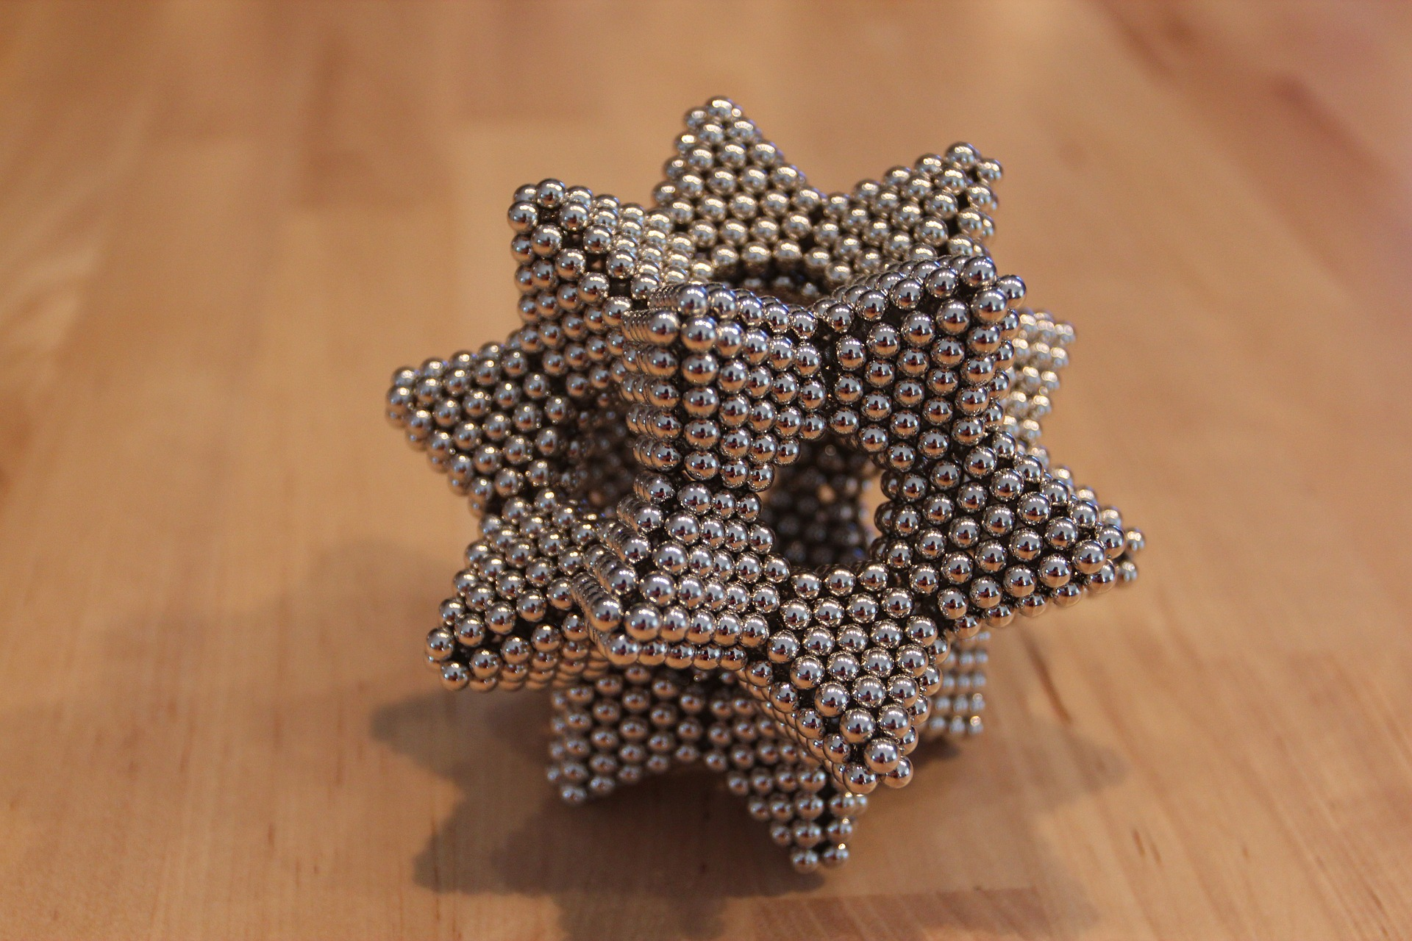
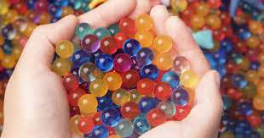
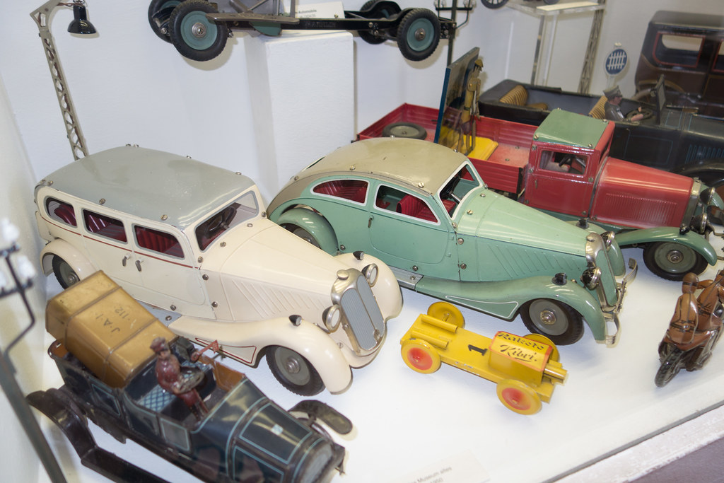
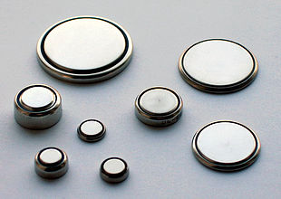
TOYS
High Powered Magnets
Water Beads
Antique Toys
Toys with Disc Batteries

Slide 17
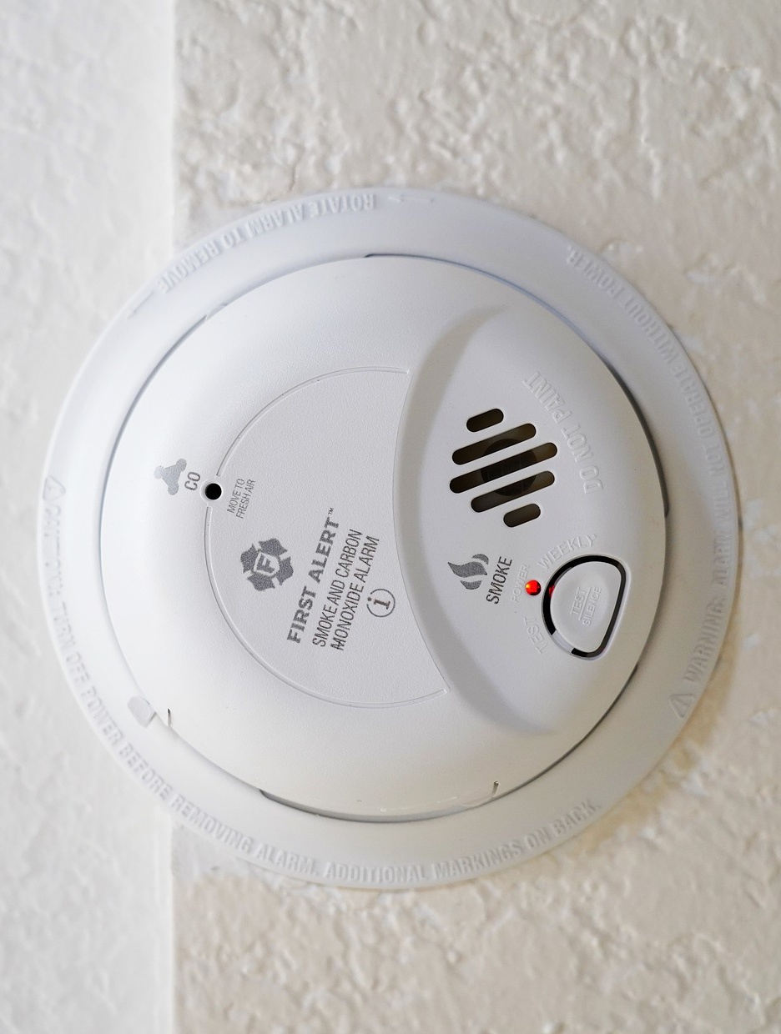
CARBON MONOXIDE
“
Notes:
With the wider use of and availability of cannabis comes the risk of increased exposure. We have seen a steady increase of calls related to children 5 years or younger consuming cannabis. Our data shows that the total number of calls has more than doubled every year since 2018. So, in 2020-2021 we see a large increase in total calls.
Pediatric Poisonings Associated with Ingestion of Marijuana Products
#1245 pediatric patient visits in children 0-11 years
77% were for children under 5 years
Male 51%
Edible 578%
55.5% admitted or transferred
60% summer/spring

Slide 18
420
>100,000
Deaths in the U.S. yearly
ED visits each year
Notes:
Every year, at least 420 people die in the U.S. from accidental CO poisoning. More than 100,000 people in the U.S. visit the emergency department each year due to accidental CO poisoning. There are steps you can take to help protect yourself and your household from CO poisoning. CDC
WHERE DOES CO COME FROM?
If you are using something that runs on batteries or electricity, there is no risk of CO. Carbon monoxide is a risk when fuel is burning to make heat or to power a tool, but the fuel is not burning cleanly with lots of fresh air and good ventilation. Things that burn gasoline, natural gas, propane, kerosene, coal, wood, charcoal, tobacco and the like can make CO. For example, a car, furnace, fireplace, hot water heater, portable space heater, stove, engine powered tool, or charcoal grill can become a source of CO.
If the equipment is operating properly and there is good ventilation, there will not be a problem. For example, there is no problem with barbequing on a charcoal grill outside because any CO that is made floats away to nothing in the open air. But bring that same charcoal grill inside the house, and the carbon monoxide can collect to dangerous levels. Likewise, a regular motor vehicle is fine outside on the road. But if it runs for a long time in a garage with the door closed, a harmful level of CO can collect.
Carbon monoxide exposures become more frequent during cold weather because more people are burning fuel to make heat or energy.
WHAT SYMPTOMS DOES CO EXPOSURE CAUSE?
In its early stages, the illness that follows CO exposure looks a lot like the flu with headache, dizziness, upset stomach, tired or overall sick feeling. If the CO level is just a little high, it may cause only difficulty thinking or memory problems.
Children can get sick from CO while the adults still feel fine.
Serious problems can come next, such as passing out or heart attacks.

Slide 19
HOW CAN POISON CENTERS HELP?
02
“

Slide 20
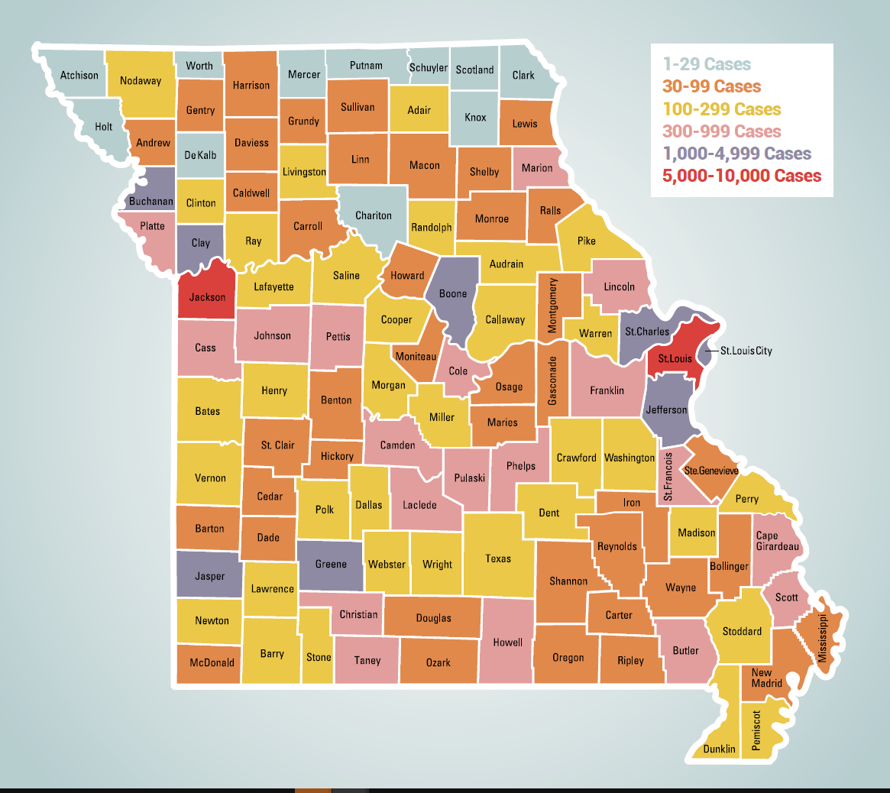
POPULATION SERVED
114 Counties
Total Population: ~6 million
18th largest state in the US
Highest number of exposures are in the metropolitan areas of St. Louis and Kansas City but we receive calls from every county.

Slide 21

WHO IS SERVING MISSOURI?
’’
“
Notes:
Advanced-training Pharmacists and Nurses
18 Nurse SPIs
10 Pharmacist SPIs
1 Education Outreach Nurse
Additional training to become Certified as Specialists in Poison Information (CSPI)
Clinically supervised by a full-time board-certified physician toxicologist

Slide 22
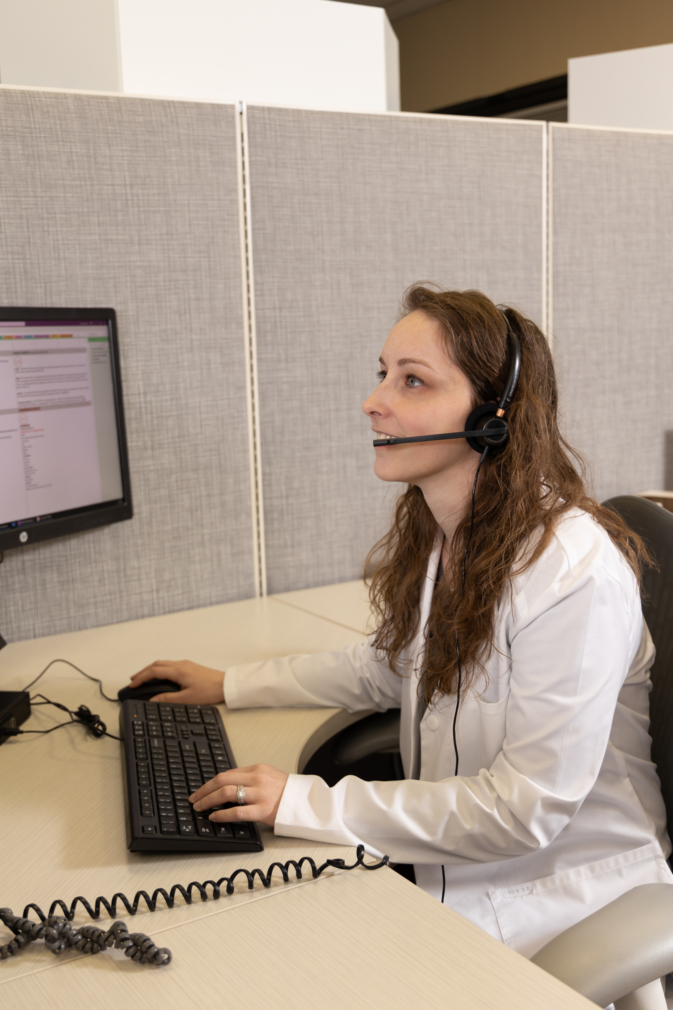
PATIENT CARE PATHS
Call
General
Public
Reassurance
Home care & follow up calls
Health Care Facility
Detailed consultation
Follow up until known outcome

Slide 23
Our goal is to save unnecessary ED visits
25%
Healthcare Facility
75%
Home
Notes:
Reduced our referral rate by 44%

Slide 24
HARM REDUCTION STRATEGIES
03
“

Slide 25

POISONINGS ARE….
PREDICTABLE
Time of day
Disruption in household
Reliance on child-resistant packaging
PREVENTABLE
Accessibility
Proper storage
Education
Notes:
Predictable
Time of day
Disruption in household
Relying on child resistant packaging
Preventable
Accessibility
Proper storage
Education

Slide 26
PREVENT POISONING
STORE | SECURE | TEACH
Put products away after use. Keep products in original container. Use child-resistant containers whenever possible. | Lock all medicines and household products out of the sight and reach of children. Be on the look out for pill boxes/planners and visitors' bags and purses. | Teach children to ask before touching or tasting anything they find on their own. Save the Poison Help line in your phone: 1-800-222-1222.

Slide 27
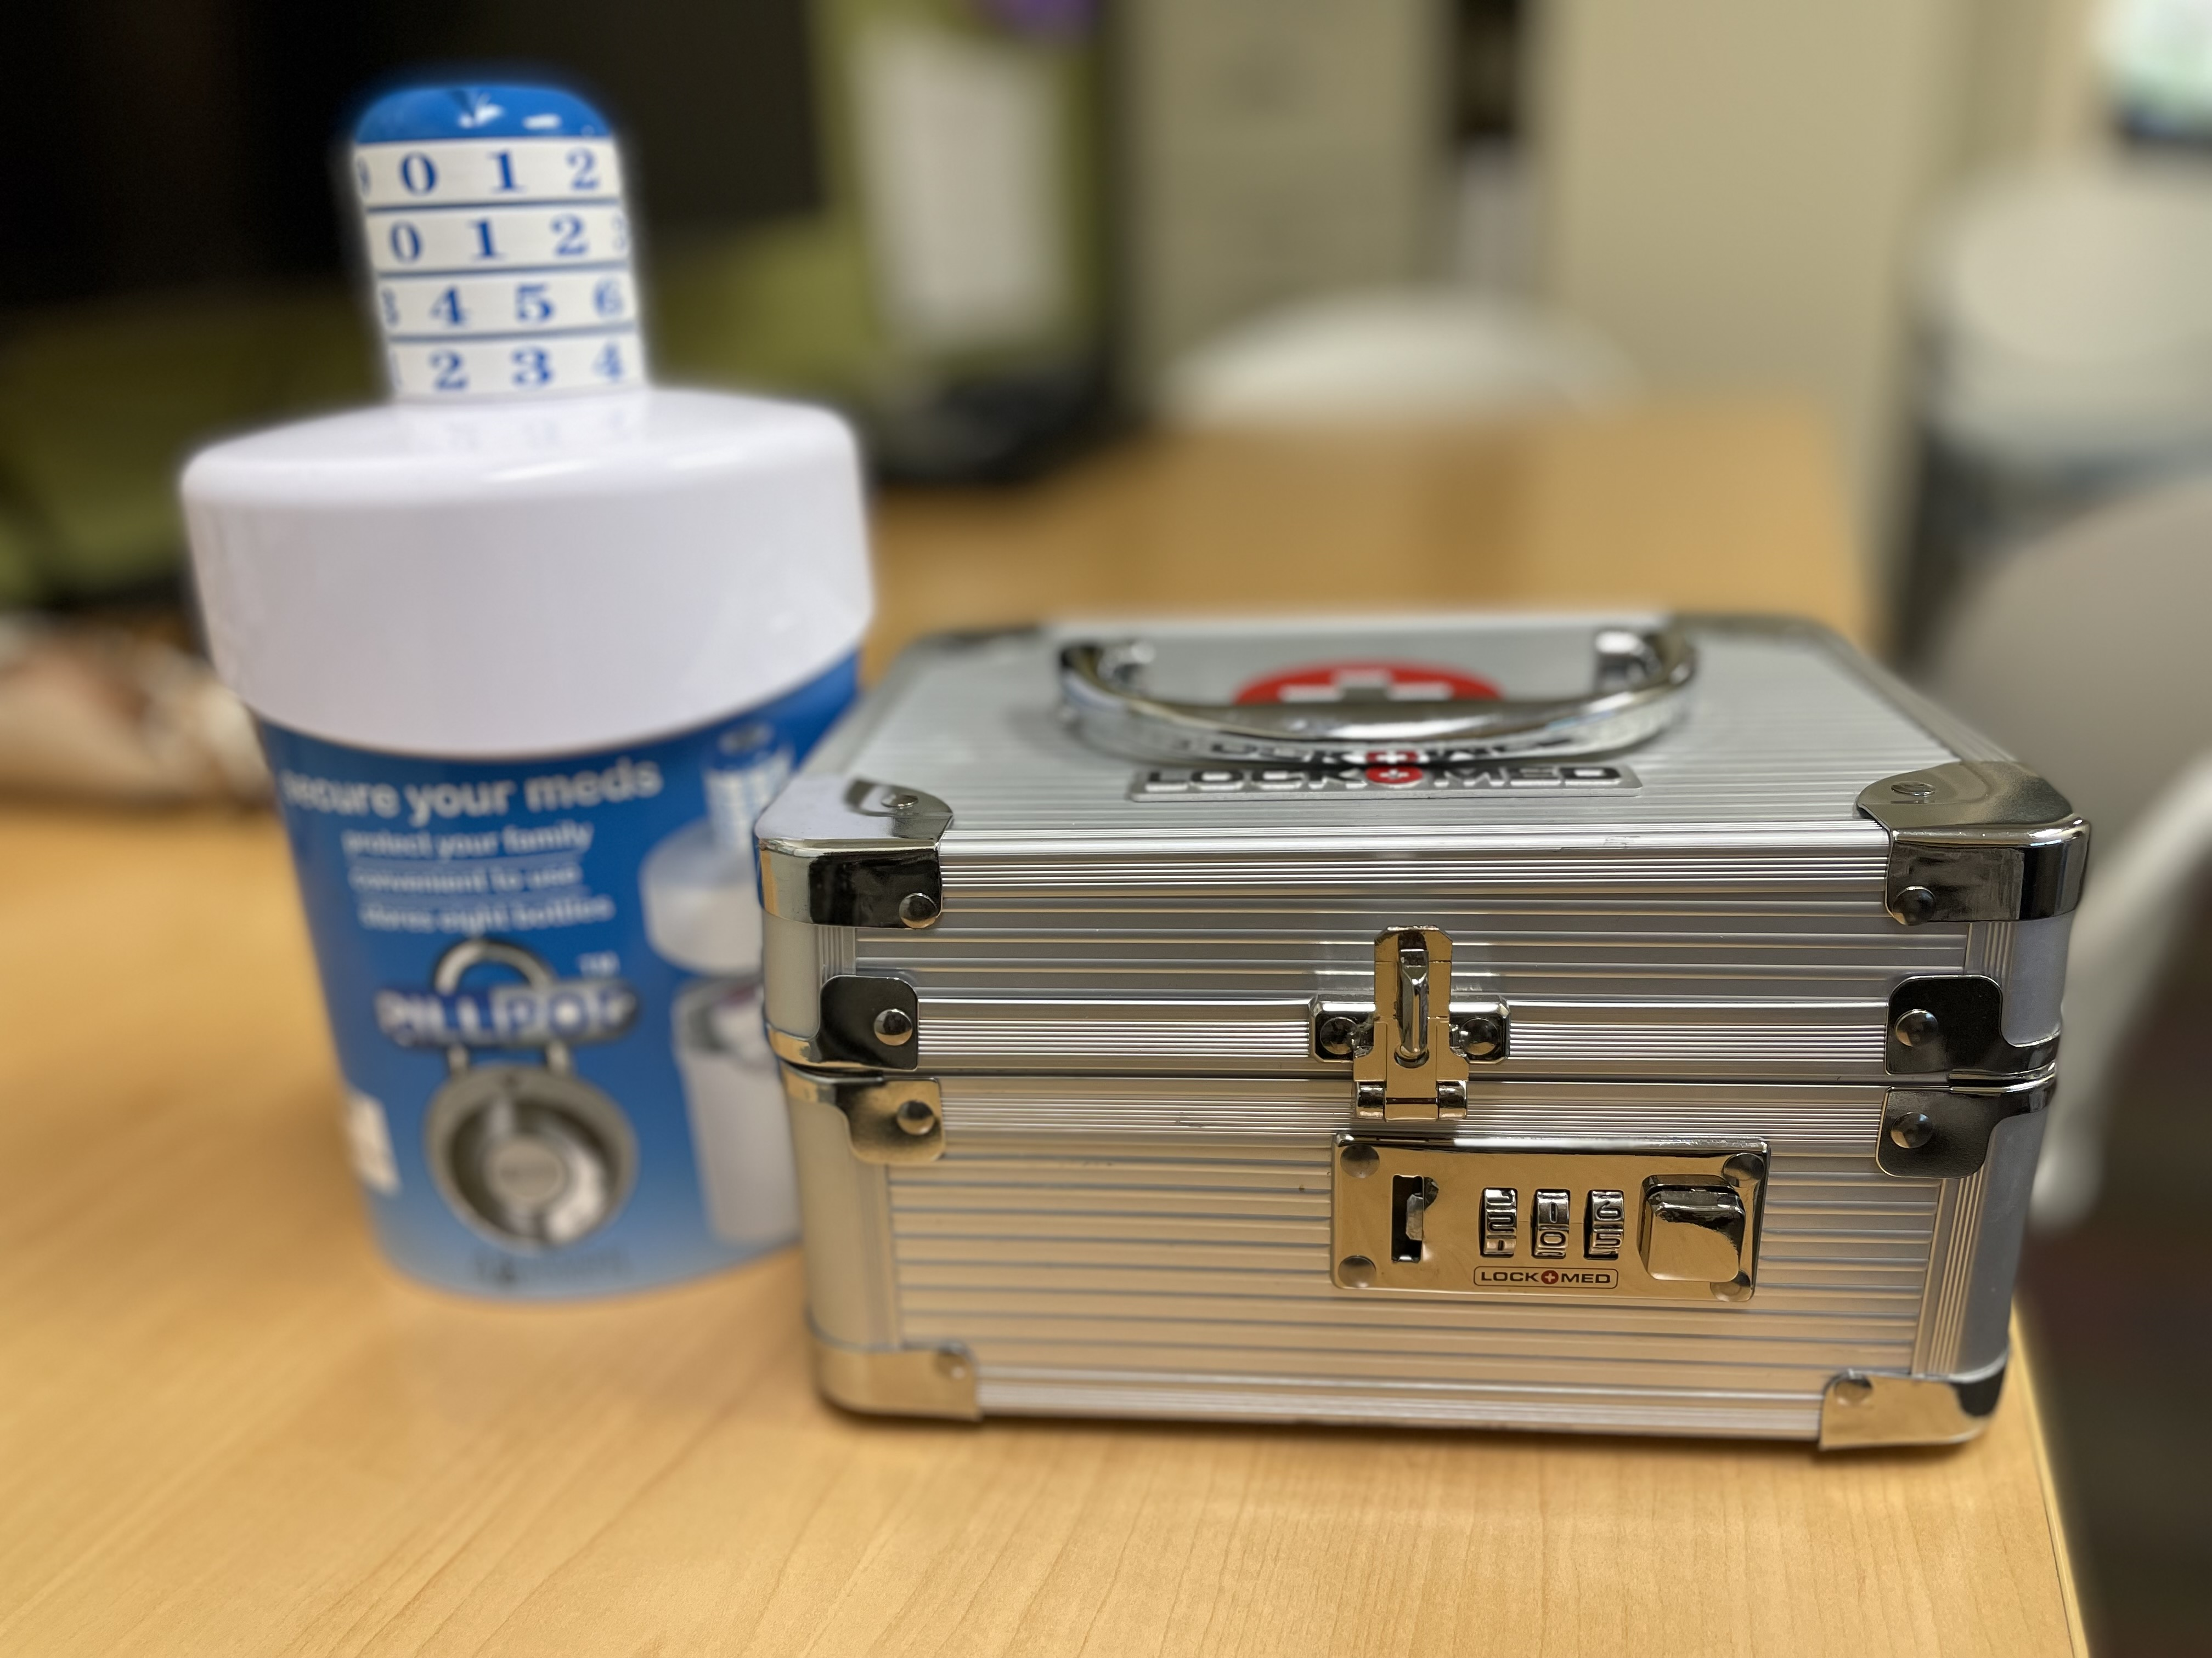
MEDICINE TIPS
Safe disposal
Keep small quantities
Reduce refill amounts
Never call medicine candy
Use the measuring device that comes with the product.

Slide 28
CANNABIS PREVENTION
Keep cannabis products in their original packaging.
After each use, ensure the package is properly resealed and re-stored.
Store edibles and cannabis products in a locked cabinet, cupboard, or drawer high-up out of children’s reach.
Use cannabis products away from children and not in front of them, as children like to mimic adults.
Keep purses and bags that belong to you or your friends out of reach from children as they may have cannabis products or other medications that can be poisonous to children.

Slide 29




CARBON MONOXIDE PREVENTION
10 FEET
CHANGE
CO detectors on each level within 10 ft of sleeping areas
Replace battery twice yearly
INSPECT
NEVER
Fuel burning appliances and chimney systems yearly.
Do not leave a vehicle running in a garage even is door is open.
Notes:
The best prevention of CO poisoning is to install CO detectors on each level that are within 10 feet of sleeping areas, near attached garages, and between 15-25 feet from fuel-burning appliances and fireplaces
Check or replace the battery when you change the time on your clocks each spring and fall (daylight savings time). Hard wired or plug-in CO alarms should have battery backup
Do not use any gasoline-powered engines, such as mowers, weed trimmers, chain saws, small engines or generators in enclosed spaces. Make sure generators are used outdoors at least 20 feet from doors, windows, and vents
Have fuel-burning appliances, venting and chimney systems in your home inspected by a professional technician at the beginning of each heating season. Chimneys can be blocked by debris. This can cause CO to build up inside your home or cabin.
Never leave an automobile engine running in a garage, even if the garage door to the outside is open. Fumes can build up quickly.

Slide 30

POISON PREVENTON LESSON PLANS
https://missouripoisoncenter.org/poison-prevention-lesson-plans/

Slide 31
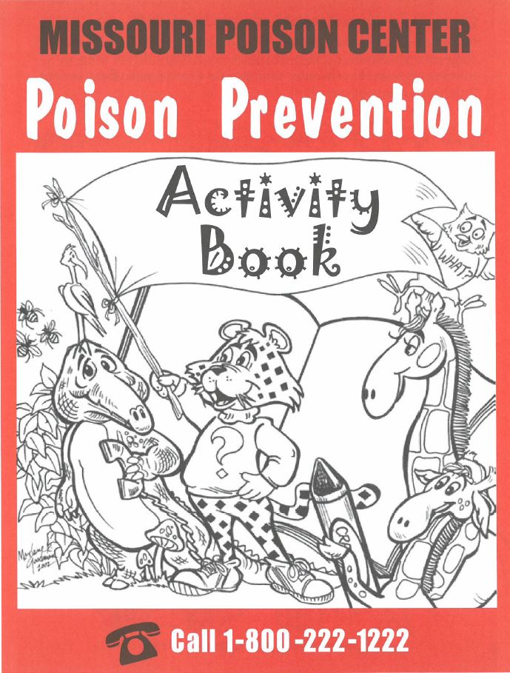
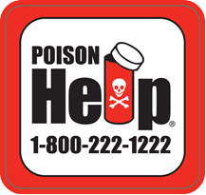
REQUEST FREE MATERIALS
https://missouripoisoncenter.org/materials-category/order-materials/

Slide 32
REFERENCES
David D. Gummin , James B. Mowry , Michael C. Beuhler , Daniel A. Spyker , Laura J. Rivers , Ryan Feldman , Kaitlyn Brown , Nathaniel P.T. Pham , Alvin C. Bronstein & Carol DesLauriers (2023) 2022 Annual Report of the National Poison Data System® (NPDS) from America’s Poison Centers®: 40th Annual Report, Clinical Toxicology, 61:10, 717-939, DOI: 10.1080/15563650.2023.2268981
Hammig B, Jones C, Haldeman S. Pediatric Poisonings Associated With Ingestion of Marijuana Products. J Emerg Med. 2023 Feb;64(2):181-185. doi: 10.1016/j.jemermed.2022.12.025. Epub 2023 Feb 21. PMID: 36822984.
Berg SE, McCann SD. Pediatric Toxicology: An Updated Review. Pediatr Ann. 2023 Apr;52(4):e139-e145. doi: 10.3928/19382359-20230208-05. Epub 2023 Apr 1. PMID: 37036778.

Slide 33

THANKS!
Do you have any questions?
Amanda.Ruback@ssmhealth.com
314-612-5719
Missouripoisoncenter.com
Please keep this slide for attribution

